Slide 1
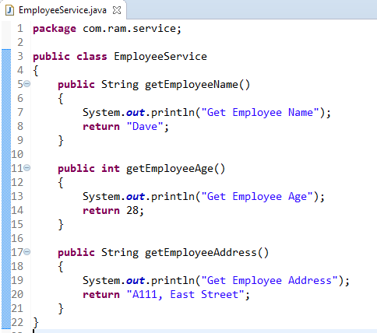
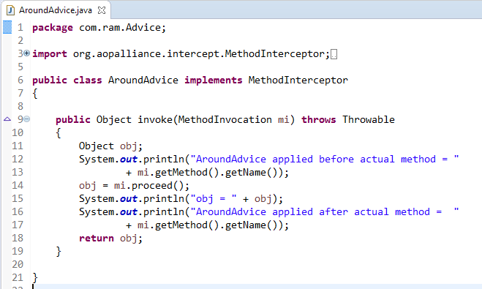
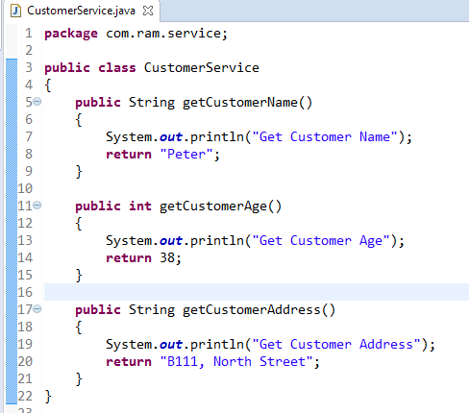
How to apply aroundAdvice for getEmployeeAge() and getCustomerAge() method.
How to apply AroundAdvice only for the method getEmployeeAge() and don’t apply for other methods?
We can match the method via following two ways :
Name match
Regular repression match

Slide 2
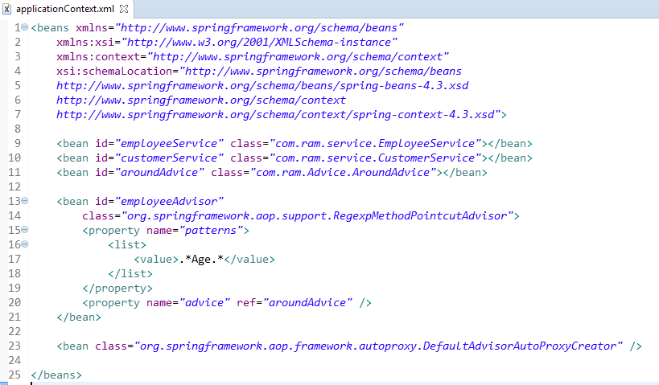
Spring comes with two auto proxy creators[
1. BeanNameAutoProxyCreator
2. DefaultAdvisorAutoProxyCreator]
to create proxies for your beans automatically.
This DefaultAdvisorAutoProxyCreator is extremely powerful, if any of the beans is matched by an advisor, Spring will create a proxy for it automatically. This is just over power, since you don’t have control what bean should be proxy, what you can do is just trust Spring will do the best for you. Please take good care if you want to implement this into your project.

Slide 3
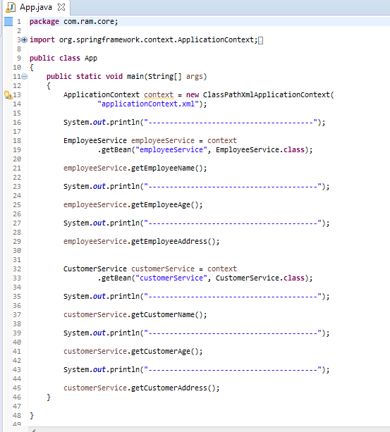

Slide 4
